Slide 1


New York City - Safest Borough
Gun violence in the 21st century

Slide 2



New York City - The City of Dreams
New York City is seen as the city of dreams where anything is possible. Success stories are born in the city. Movies and TV shows often depict a struggling artist who moves to NYC and becomes extremely successful. But NYC wasn’t always seen as this.

Slide 3

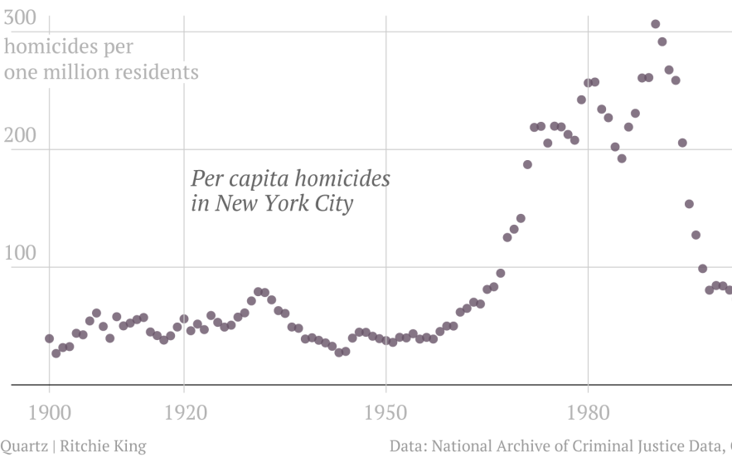
How “Fear City” became “The City of Dreams”
In the 1970’s crime and violence in new york city was rampant. NYC was coined “Fear City” Where police corruption and crime ruled.
Violence peaked in the early 1990’s.
There are several theories why violence went down: Broken Window Policing, Stronger repercussions for law breaking, etc
Our study will explore whether or not this downward trend is continuing.

Slide 4

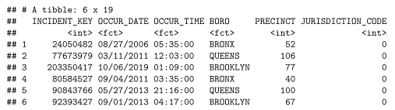

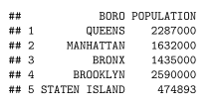
Datasets - NYPD Historical Dataset + Population
Original Dataset contains 19 features (NYPD)
The dataset breaks down each time a shooting incident has occured in NYC since 2006. The dataset also includes information about the victim and perpetrator. We also know whether or not an incident was fatal.
*Transforming and Cleaning Data reduced our data to 7 features
Since 2006:
23,585 Shooting Incidents
4,500 Shooting related deaths
Population Dataset (Census)
The population for each Borough was taken from the census data. This information will be to properly compare between different Boroughs.

Slide 5
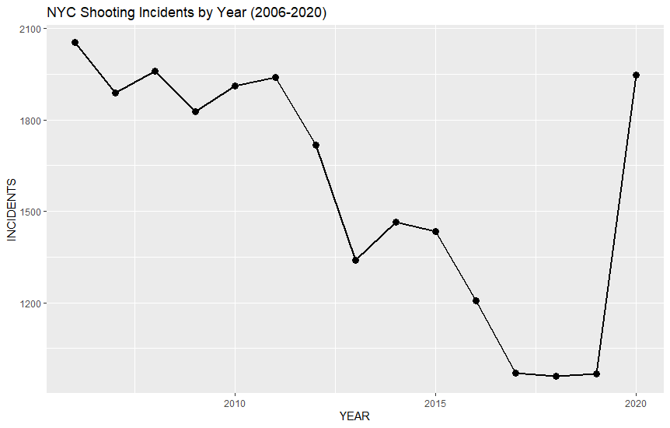
Number of shooting incidents has been decreasing yearly
Until Covid...
Since 2006, shooting incidents in NYC were decreasing every year. Before starting the analysis, I thought 2020 would have much fewer incidents because people who remain at home because of COVID. That assumption was proven to be false.
Covid and potentially other factors (2020 was also a hotly contested election year) actually increased the number of shooting incidents.
(see bias section - slide 10 for more info).
2006

Slide 6
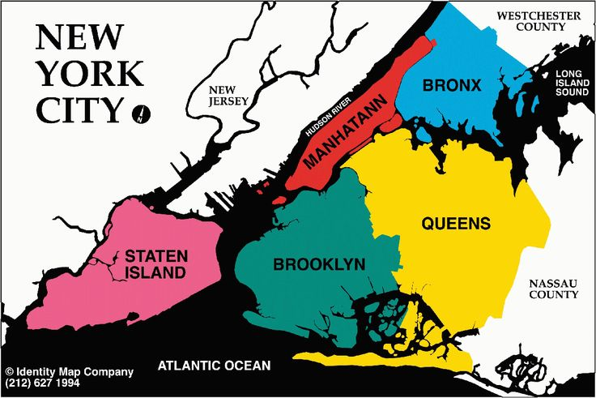
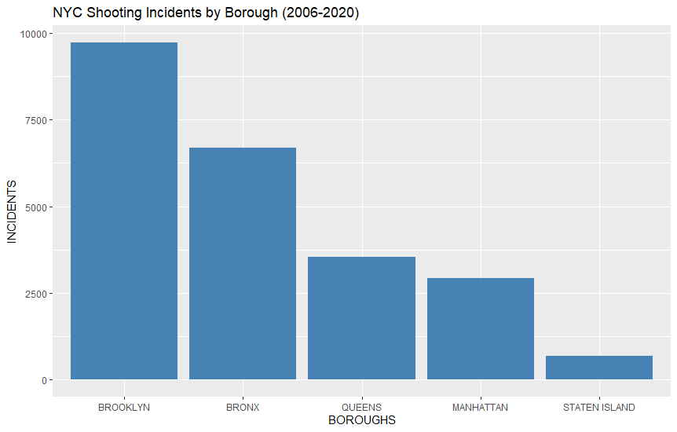
Which Boroughs have the highest number of incidents?
NYC is broken into 5 unique boroughs:
From a pure number of incidents perspective, Brooklyn has the highest number of shooting incidents.

Slide 7
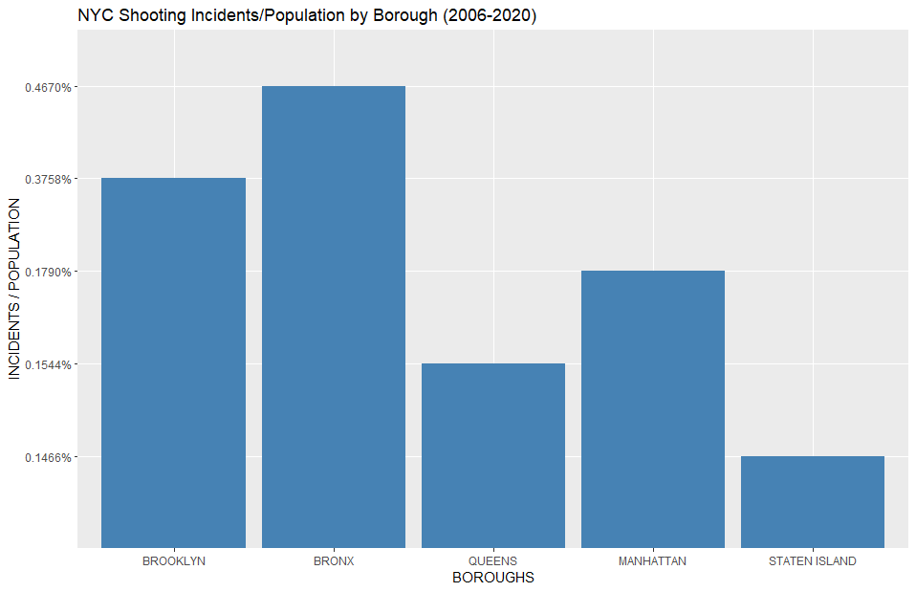
Revisiting Shooting Incidents with Population
Population data
Using this information we can create a new metric:
# of Shooting incidents / Population
This metric will allow us to more compare the 5 boroughs since the population discrepancies between each borough is very large
BRONX is the borough with the most incidents/population

Slide 8
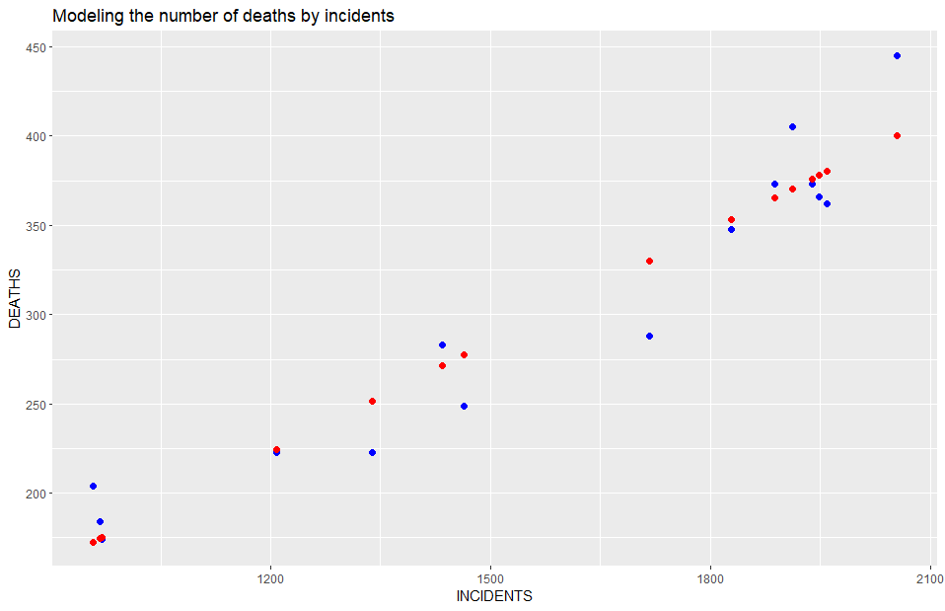
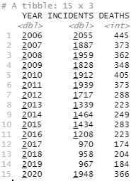
Modeling the number of deaths using Linear Regression
Using our cleaned and aggregated data we will use # of incidents to predict the number of deaths
Actuals
Pred
Notes:
It looks like we are able to create a fairly accurate model to represent the number of gun related deaths using the # of gun shooting incidents.

Slide 9
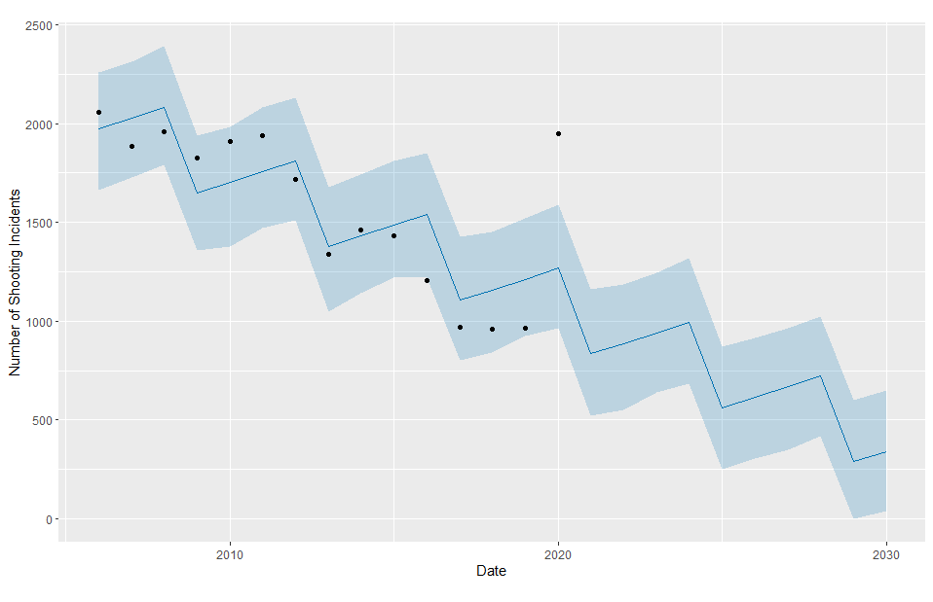
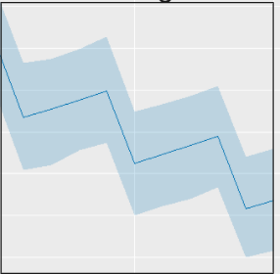
Using Facebook Prophet to forecast # of incidents
Shooting Incidents by date
Forecasted region
Facebook created a specialized package for R that is extremely useful for time-series data.
This package was used to forecast the number of shooting incidents into the future.
Actuals
Model predicts a continued downward trend in shooting incidents (it considers 2020 an outlier year)
Forecast

Slide 10

Bias Identification
Personal Bias
Information Bias
As previously mentioned, one of my personal biases was the belief that there would be less shooting related incidents during 2020 because of COVID.
I assumed that people would be locked down at home. From examining the data (slide 5) that assumption was proven to be false. COVID and potentially other factors (2020 was also a hotly contested election year) actually increased the number of shooting incidents.
Another bias that I noticed would potentially be the time the shooting incident was recorded. Since these observations are human dependent, I wanted to remove it entirely from my dataset. I also wanted to remove any factors involving race.
There have been several algorithms which ended up being inherently racist. See this MIT article describing police specific algorithms:
Notes:
prejudice in favor of or against one thing

Slide 11

Conclusion
We cleaned, examined, visualized, analyzed and modeled the data from the NYPD. It looks like the number of shooting incidents has been steadily decreasing year of year, until we hit 2020. Where it seems that COVID (and potentially other factors) seem to have had a negative impact and has lead to an increase in the number of shooting incidents.
The Bronx seems to be the most violent borough in NYC with the highest number of shooting incidents population.
Finally, we showed that we are able to model the number of shooting related deaths by using the # of shooting incidents and using Facebook Prophet we forecasted a downward trend for the 5 next years.

Slide 12
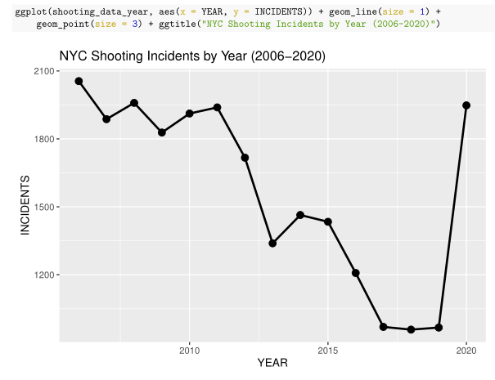
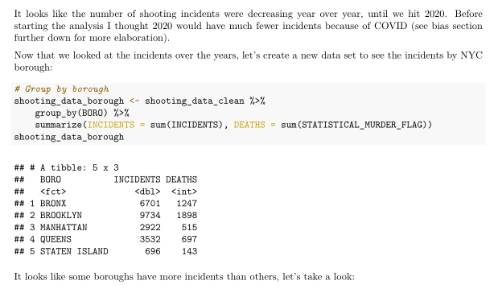
Backup Slides
Full R Markdown file can be found on Github. The document contains the full analytical breakdown and the code for the visualizations:

